Slide 1
EIGHT-YEAR ASSESSMENT
Notes:
Meg – does opening welcome
Warmer here?
Traveled the farthest?
Traveled the most hours?
Meg introduces Kim

Slide 2
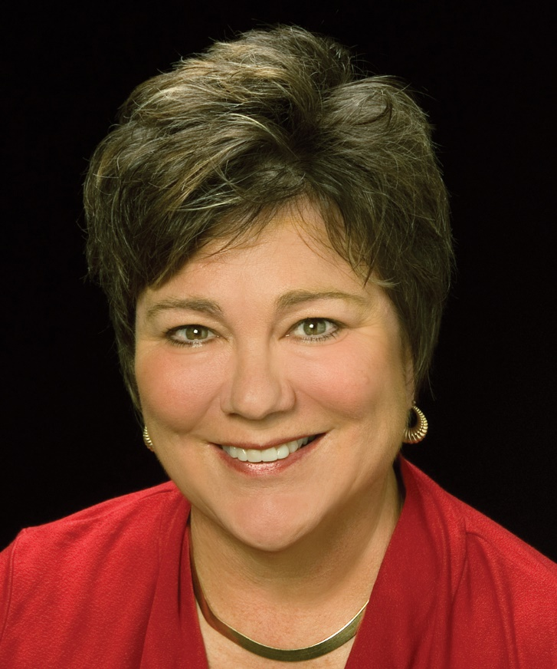
WELCOME
Rev. Dr. Kim Cape
General Secretary
Notes:
7:00 – 7:10
Kim Cape makes opening comments
Greg begins his presentation after Kim is finished. Greg introduces himself.

Slide 3
A Holistic and Transformative Process
8YA
8YA
8YA
Course of Study
Ordination, FM
Seminary
8YA
Provisional
Clergy Life-long Learning
Candidacy
Local Pastor, AM
Discernment
Retirement
Assessment, Evaluation, Supervision, and Formation: intellectual engagement, spiritual and character formation, leadership development, and well-being;
An Ecology of Call: from the first moment of discernment to the decision to enter the retired relationship;
Notes:
7:10 – 7:14
Greg presents
Greg will put together his own slides
When Greg is finished, he needs to make a segue statement between Greg and Trip.

Slide 4
A Holistic and Transformative Process
Paired Contrasts: responsible grace and structured freedom, capacity building and competency training, education and formation, doctrine and practice, identity and vocation, being and doing;
Learning Experience: initiate, inform, inspire, integrate, innovate, implement, and impact;
Know your Why! (Michael Jr.)
Notes:
7:10 – 7:14
Video – 7:14 – 7:17
Greg presents
Greg will put together his own slides
When Greg is finished, he needs to make a segue statement between Greg and Trip.

Slide 5
1
Pick up your device and hold it in your non-dominant hand. If you’re using a computer, just leave it on the table. Don’t try to hold it in one hand.
2
Type “menti.com” in the web browser using your dominant hand.
3
Enter the EYA code 61 78 46 in the box labeled, “Please enter the code”.
4
Select, “Submit” (this is an important step)
Type your answer for a word cloud or make your selection for multiple choice.
5
6
Select, “Submit” again (this is another important step)
7
Give your neighbor a high-five because you just did something awesome.
Notes:
7:17 -

Slide 6
In 1 word, what does baptism mean to you?

Slide 7
BAPTISM
Incorporation into Christ’s Church
A sign of “regeneration or the new birth”
Sign of the covenant between God and God’s people
Mark of Christian discipleship
Notes:
Baptism is about:
INCORPORATION INTO CHRIST’S CHURCH... which literally means “INTO THE FORM OF A BODY” which literally means, “into the form of a body”. A body develops. It changes and adapts and develops so each member can meet current needs.
A sign of “REGENERATION OR THE NEW BIRTH”... and regeneration is about BEING ONE THING AND DEVELOPING INTO SOMETHING NEW.
Sign of the COVENANT BETWEEN GOD AND GOD’S PEOPLE,... covenant is about RELATIONSHIP and a relationship is about growth and change and a deepening understand of who we are to each other.
MARK OF CHRISTIAN DISCIPLESHIP... and discipleship is about a journey, a FOLLOWING OF JESUS, and following someone means movement from one place to another…
AND MOVEMENT IS ABOUT MOVING FROM ONE PLACE TO ANOTHER.

Slide 8
BAPTISM
Incorporation into Christ’s Church
A sign of “regeneration or the new birth”
Sign of the covenant between God and God’s people
Mark of Christian discipleship
Notes:
Baptism is about:
INCORPORATION INTO CHRIST’S CHURCH... which literally means “INTO THE FORM OF A BODY” which literally means, “into the form of a body”. A body develops. It changes and adapts and develops so each member can meet current needs.
A sign of “REGENERATION OR THE NEW BIRTH”... and regeneration is about BEING ONE THING AND DEVELOPING INTO SOMETHING NEW.
Sign of the COVENANT BETWEEN GOD AND GOD’S PEOPLE,... covenant is about RELATIONSHIP and a relationship is about growth and change and a deepening understand of who we are to each other.
MARK OF CHRISTIAN DISCIPLESHIP... and discipleship is about a journey, a FOLLOWING OF JESUS, and following someone means movement from one place to another…
AND MOVEMENT IS ABOUT MOVING FROM ONE PLACE TO ANOTHER.

Slide 9
BAPTISM
Incorporation into Christ’s Church
A sign of “regeneration or the new birth”
Sign of the covenant between God and God’s people
Mark of Christian discipleship
Notes:
Baptism is about:
INCORPORATION INTO CHRIST’S CHURCH... which literally means “INTO THE FORM OF A BODY” which literally means, “into the form of a body”. A body develops. It changes and adapts and develops so each member can meet current needs.
A sign of “REGENERATION OR THE NEW BIRTH”... and regeneration is about BEING ONE THING AND DEVELOPING INTO SOMETHING NEW.
Sign of the COVENANT BETWEEN GOD AND GOD’S PEOPLE,... covenant is about RELATIONSHIP and a relationship is about growth and change and a deepening understand of who we are to each other.
MARK OF CHRISTIAN DISCIPLESHIP... and discipleship is about a journey, a FOLLOWING OF JESUS, and following someone means movement from one place to another…
AND MOVEMENT IS ABOUT MOVING FROM ONE PLACE TO ANOTHER.

Slide 10
BAPTISM
Incorporation into Christ’s Church
A sign of “regeneration or the new birth”
Sign of the covenant between God and God’s people
Mark of Christian discipleship
Notes:
Baptism is about:
INCORPORATION INTO CHRIST’S CHURCH... which literally means “INTO THE FORM OF A BODY” which literally means, “into the form of a body”. A body develops. It changes and adapts and develops so each member can meet current needs.
A sign of “REGENERATION OR THE NEW BIRTH”... and regeneration is about BEING ONE THING AND DEVELOPING INTO SOMETHING NEW.
Sign of the COVENANT BETWEEN GOD AND GOD’S PEOPLE,... covenant is about RELATIONSHIP and a relationship is about growth and change and a deepening understand of who we are to each other.
MARK OF CHRISTIAN DISCIPLESHIP... and discipleship is about a journey, a FOLLOWING OF JESUS, and following someone means movement from one place to another…
AND MOVEMENT IS ABOUT MOVING FROM ONE PLACE TO ANOTHER.

Slide 11
Know where you are but also know
you probably won’t stay there.
- a very wise person
Notes:
About movement… [quote]…
We don’t remain the same. We grow, develop new skills, have new passions

Slide 12
AN APOSTOLIC TIMELINE
FISHERMAN
APOSTLE
STUDENT
INTERN
SOLO PASTOR
CHURCH LEADERSHIP
WRITER
MARTYR
APPRENTICE
BOAT OWNER
FOLLOWER
MULTI-SITE
DS / BISHOP
Notes:
The first time Jesus meet the apostles, he didn’t immediately ask them for a draft of their respective Gospel text.
They began as one thing and developed into something new…

Slide 13
A VERY NON-APOSTOLIC TIMELINE
STUDENT
SECULAR PROFESSION
SCHOOL TEACHER
TEACHER ASSISTANT
COLLEGE SOCCER
SOCCER
SEMINARY
SENIOR PASTOR
GENERAL AGENCY
UMYF, FCA
STUDENT GOV & FRATERNITY CHAPLAIN
UMYF LEADERSHIP
LAY LEADERSHIP
RELIGIOUS FORMATION
ASSOCIATE PASTOR
Notes:
Just like the Apostles, we grow and develop and become something new. I did.
I don’t know what’s next for me but I am fairly certain that there will be a next for me.

Slide 14
Insert call exploration
word cloud
mentimeter here
What did you do before vocational ministry?
Notes:
We were all something else before we became what we are today.

Slide 15
LISTEN
DISCERN
RESPOND
Notes:
Know where you are - but also know you won’t stay there.
This is how we discern where God may be calling us to…
LISTEN to what God is saying through SPIRITUAL PRACTICES (meditation, prayer, scripture reading…)
DISCERN what you think God has said ALONE & in COMMUNITY, paying attention to AFRIRMATIONS from God (vertical) and AFFIRMATIONS FROM OTHERS (horizontal)
RESPOND with what you believe to be the NEXT FAITHFUL STEPS
Then repeat the process because exploring your call never ends.

Slide 16
LISTEN
prev. 8 yrs
DISCERN
6 mo assessment
RESPOND
to assessment findings
Notes:
You can understand the EYA with the same process because, at the heart of the EYA, is a hope for growth and development and faithfulness to who God is calling us to be.
LISTEN during the PREVIOUS 8 YEARS
DISCERN during the 6 MONTH ASSESSMENT SEASON
RESPOND to the ASSESSMENT’S FINDING with your NEXT FAITHFUL STEPS
Then repeat the process EVERY 8 YEARS because exploring your call never ends.

Slide 17
We need to stay aware of where God is moving and where God is moving us in ministry.
- the same wise person that said the other thing
Notes:
7:17 – 7:30
This is the hope of the eight yea assessment… [quote]

Slide 18
TEAM DISCUSSION
Beyond the Book of Discipline requiring this work, why will your annual conference offer the Eight-Year Assessment process?
What are the Biblical and theological underpinnings of this work for your annual conference?
For whom is the Eight-Year Assessment process designed?
Notes:
15 min. – 7:30 – 7:45
Here’s a chance to verbalize what you’ve HEARD, what you’re thinking, and what you HOPE TO DO.

Slide 19
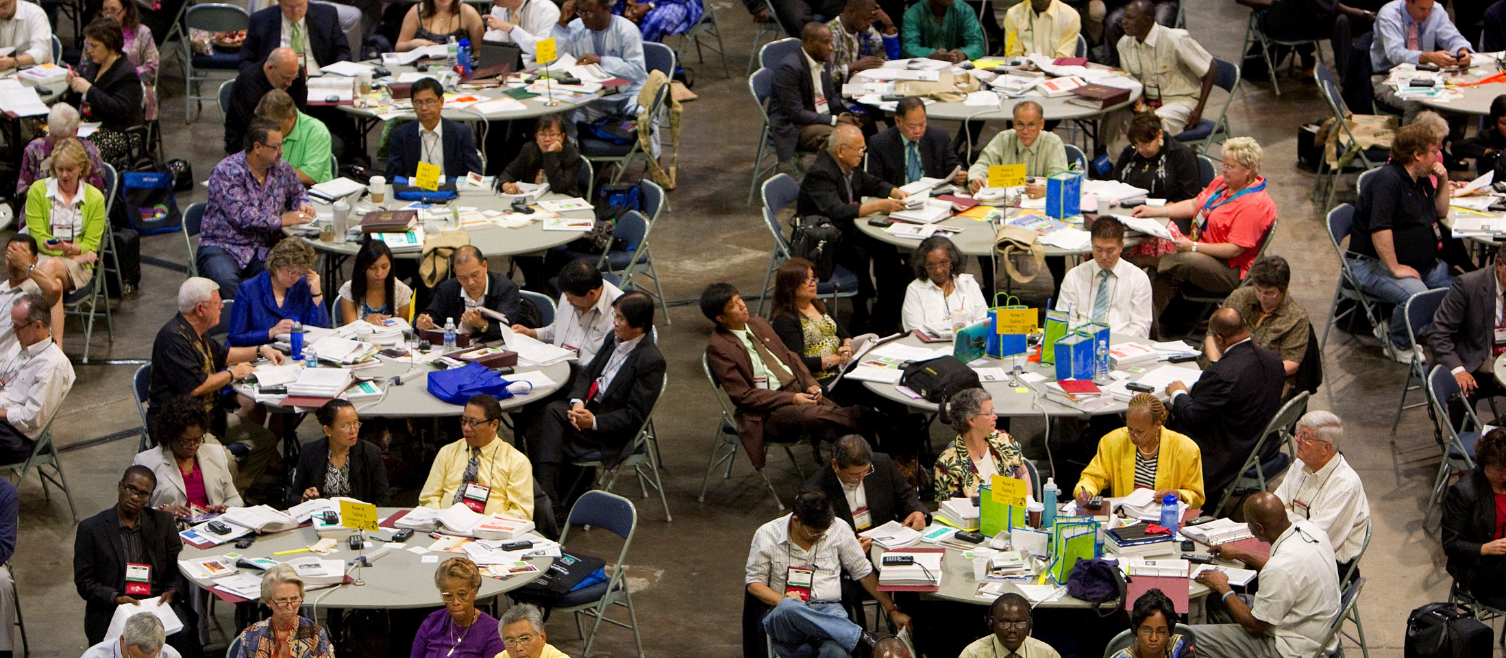
STUDY OF MINISTRY COMMISSION
Notes:
7:45 – 7:48
The Eight-Year Assessment was a proposal brought to the General Conference by last quadrennium’s Commission on the Study of Ministry. One of the tasks assigned to the Ministry Study was to examine the process of clergy formation and to further define the Order of Elder – especially as people mature throughout their ministries.
While candidates have a lot of interaction and touchpoints with the conference, district committees, and BOM’s while in the candidacy, licensing, and provisional membership process (and, yes, that’s a whole other story, isn’t it?), part of the Commission’s work was to consider ways that clergy could continue to receive support and engage in intentional formation processes throughout life.
Not surprisingly, the Eight-Year Assessment comes to us now with mixed interpretations. Some are concerned about the negative implications of assessment, some are cautiously optimistic about how a successful formation and development plan could help in supporting licensed and ordained clergy. And some are just waiting to see how it’s all going to play out.
So – where do you fit along this spectrum?
I believe the Eight-Year Assessment has been developed to weed out ineffective clergy.
True, False, or Waiting to See
Meg introduce Tom Choi to talk further about the how the EYA came into being and what the MSC was hoping for by creating an EYA

Slide 20
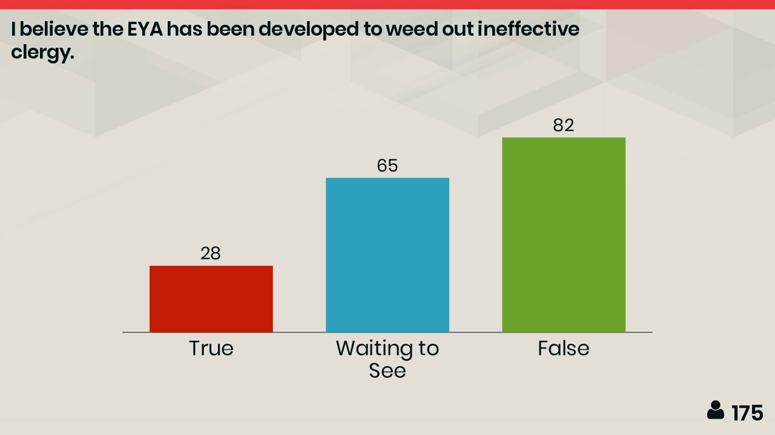
Insert developed
word cloud
mentimeter here
I believe the EYA has been developed to…
Notes:
7:45 – 7:48

Slide 21
Background and Proposal
Is this a good thing or a bad thing?
Study on Ministry Background – subgroup on the Nature and Grounding of the Elder
Pneumatological sense of call – Holy Spirit led
Academic cycle of assessment, research, learning, and retooling
Need for all clergy to assess and retool
Sense of isolation among clergy after residency
Notes:
7:48 – 7:58
Meg introduces Tom – member of last quadrennium’s Study of Ministry Commission
Tom Choi presents

Slide 22
Background and Proposal
Possible components
Supportive groups
Mentoring and coaching
In-depth look at last eight years
Tools such as 360 Review, Strength Finders, Psychological Assessments, etc.
Formation goals and planning for the next eight years
Notes:
7:48 - 7:58
Tom Choi presents

Slide 23
Desired Outcomes
Denominational Change
Clergy who flourish in ministry and in life
Shift away from blaming clergy
Greater accountability from all
Healthier congregations and annual conferences
Notes:
7:48 – 7:58
Meg speaks at this slide

Slide 24
The Elephant in the Room
The Perceived Punitive Feel of This
Each Annual Conference formulates the process and sets the tone: Launch in 2020
Bishops, Cabinets, BOM members create a positive tone and be the first to do the assessment
¶ 419.1 – The role of the DS as Chief Missional Strategist for the District
Notes:
7:48 – 7:58
Meg introduces the small group questions

Slide 25
TEAM DISCUSSION
What kind of leadership does your annual conference need in the next 10 to 20 years?
What change would you most like to see in clergy who participate in the Eight-Year Assessment process?
What change would you most like to see in the annual conference as a result of the Eight-Year Assessment process?
Notes:
Meg introduce questions
We hope the questions in Bishop Haller’s sermon and the questions in this session will guide your teams in thinking about outcomes and the change you want to see in your annual conferences.
Tonight is a starting point and we know you could talk about these questions for much longer than the time we have tonight.
As a way of sharing both with your teams and with the full group here, we invite you to look at the first question and populate the Word Cloud slide we will keep posted during these next 15 minutes. As your team identifies needs in your annual conference, please share one or two words through the menti app. We’ll keep this Word Cloud open during this next round of team discussion.

Slide 26
Insert kind of clergy
word cloud
mentimeter here
Kind of clergy leadership needed in the next…
Notes:
7:45 – 7:48

Slide 27
RESOURCES
Gil Rendle article
Resources from this event
Strategic Planning sheet
Cross-conference Learning Labs
Notes:
From the time we begin to discern God’s call in our lives, we find ways to listen and respond to that call. This cycle is ongoing listen, discern, and respond to the next place God calls us.
It could go either way. And we hope the Eight-Year Assessment will be a time for clergy to reflect upon and find support and resources for continued development in all different areas of health.
At GBHEM we do not see it as our role to develop what process your conference will use. Our ministry settings are too varied, and you know your context and are the best-equipped to design a plan for your conference. However, we hope to support you in finding appropriate resources and helping make connections as you consider your goals and the appropriate process to help you reach those goals.
One resource, however, that GBHEM has developed and is launching is our Effective Ministry 360. The EM360 was designed to provide pastors and congregations with the chance to identify strengths, determine how ministry goals may be achieved, and to identify ways in which the pastor and congregation can work together to meet those ministry goals. The pastor’s strengths are identified as well as areas for maximum growth potential. The EM360 considers the knowledge, skills, abilities, and personal characteristics that contribute to effective ministry in a variety of settings and allows for the pastor and congregation to work together to maximize each other’s strengths in accomplishing their stated ministry goals.
One of tomorrow’s workshop sessions will focus specifically on the EM360 should you want to find out more details about how this process will work.
You received a few other resources to help you with your work this week.
Next slide – Book of Discipline

Slide 28
¶ 349
Evaluation-Evaluation is a continuous process for formation in servant ministry and servant leadership that must take place in a spirit of understanding and acceptance. Evaluation serves as a process for pastors clergy to assess their effectiveness in ministry and to discern God’s call to continue in ordained ministry.
1. For clergy serving local churches, the district superintendent, in consultation with the pastor-parish relations committee, will evaluate annually the pastors’ each clergy's effectiveness for ministry (¶¶ 334.2c, 419, 635.2o, r), using criteria, processes, and training developed by the cabinet and the Board of Ordained Ministry. The pastors clergy in local churches shall participate annually in an evaluation with the committee on pastor-parish relations for use into enhance an ongoing effective ministry and for to identifying continuing education needs and plans (¶ 258.2g[5]), using criteria, processes, and training developed by the Board of Ordained Ministry and the cabinet. The process of evaluation shall include self-assessment and appropriate metrics, and the General Board of Higher Education and Ministry will offer models to guide cabinets and Boards of Ordained Ministry in the evaluation process.
2. Deacons in appointments beyond the local church and elders and local pastors Clergy serving in appointments to extension ministries will undergo annual evaluation by their immediate supervisors, engage in annual self-evaluation, and include copies of these evaluations in the annual report submitted to their bishop, district superintendent, and the Board of Ordained Ministry (¶ 344.2a). When possible, they shall have an annual conversation with their district superintendent about their ministry.
3. Every clergyperson shall also engage in a six-month process of personal and professional assessment and development every eight years. The process will be designed and implemented by the cabinet and Board of Ordained Ministry for each annual conference in consultation with the Chairs of the Orders of Deacon and Elders and Fellowship of Local Pastors and Associate Members. The process shall include both a formal review and an in-depth renewal opportunity, such as a retreat or series of coaching and mentoring sessions.
a. The formal review shall include a self-evaluation, metrics appropriate to the ministry settings to which clergy are appointed, observations of trends from the previous eight years, and reviews or interviews with people close to the ministry of the clergy being reviewed.
b. The in-depth renewal opportunity shall be designed by the cabinet and Board of Ordained Ministry in a form appropriate to the conference. The renewal opportunities shall include a combination of elements, such as: time apart for prayer and reflection, reflection with a covenant group, meetings with a coach, celebration of ministry milestones, and discernment of future ministry challenges and opportunities. When deemed important to help in the evaluation process, psychological assessments may be requested by the cabinet or Board of Ordained Ministry.
c. The district superintendent shall review the portfolio and provide the initial report of the eighth year review of effectiveness. When recommended by the district superintendent, a meeting with the bishop and members of the cabinet may be held.
d. Each annual conference shall develop and initiate a plan for such assessment by January 1, 2020.
Notes:
Let’s just read through this together quickly!
Ok – well, there is a handout in your folder.

Slide 29
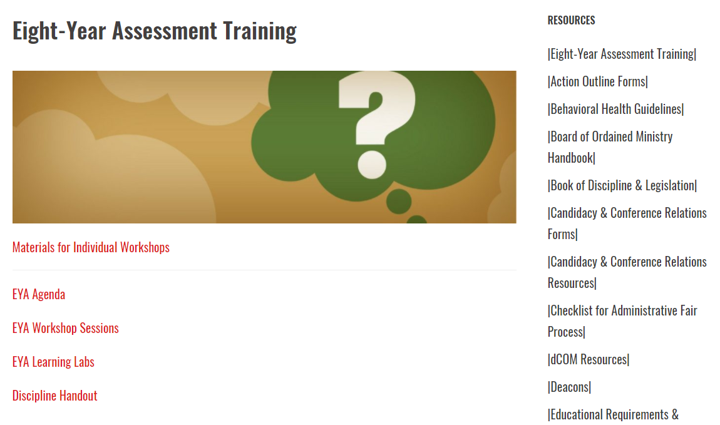
BOMLIBRARY.ORG
Notes:
Additionally, we are building a page with resources from this conference on the BOM Library. Workshops materials, plenary resources, and other information will be added to this page as they become available.

Slide 30
RESOURCES
Gil Rendle article
Resources from this event
Strategic Planning sheet
Cross-conference Learning Labs
Notes:
There is a basic outline for strategic planning in your folders and at the end of this week you’ll have the chance to meet with other conference teams to share your process and get feedback from your colleagues.
Last but not least, as we consider different ways for clergy to be healthy, Leah Holzwarth who is the Health and Wellness Manager at Wespath Pension and Health Benefits will be leading us this week in a few simple exercises to get us up and moving. She’s here tonight to lead the first one.

Slide 31
BLESSING AND SENDING FORTH
Notes:
Our plenary begins at 8:00 tomorrow, and breakfast will be available in this area beginning at 7:00.
Any other announcements
Let us stand for the benediction –
Guide us in our waking, O Lord, and guard us in our sleeping.
That awake we may watch with Christ, and asleep we may rest in peace.
Amen.

