Slide 1
Training the District Committee on Ordained Ministry
www.bomlibrary.org
Rev. Meg Lassiat
Executive Director of Candidacy and Conference Relations
mlassiat@gbhem.org
Rev. Shannon Conklin-Miller
Assistant General Secretary for Clergy Formation
sconklin-miller@gbhem.org

Slide 2
Suggested Training Topics
Discipline paragraphs
dCOM Nominations and Membership
Disciplinary responsibilities
Process and requirements
Candidacy
Licensing
Associate Membership
Provisional Membership
2016 Book of Discipline changes
Resources

Slide 3
Training Hints
Interactive exercises
Short lecture pieces
Icebreakers and introductions
Connect lesson content to application
Adults learn best when they need to

Slide 4
2016 Book of Discipline
¶ 635 Board of Ordained Ministry
¶ 666 District Committee on Ordained Ministry

Slide 5
dCOM Membership, Organization, and Responsibilities

Slide 6
Membership
At least 3 laity from district churches
At least 6 clergy from the district
Includes: deacons, elders, an associate member, one local pastor (completed COS)
BOM representative (named by the BOM)
The District Superintendent
Diversity Balance
Racial/Ethnic
Young Adult Clergy
Male/Female

Slide 7
Organization
BOM sub-committee (¶ 635.1g)
BOM trains dCOM members
BOM assigns a member to each dCOM
Nominations and term

Slide 8
Organization
Officers
Specific roles not named by Discipline
Customary
Chair or Co-Chairs
District Registrar
Secretary

Slide 9
Responsibilities
Implement Candidacy Process
Interview and recommend
Certified candidacy
Licensing
Associate and Provisional Membership
Reinstatement of membership
See BOM Handbook, Chapter 2

Slide 10
Discipline Changes and Forms

Slide 11
New Requirements for dCOM Work
¶ 205.4 – After one year, lay supply ministers begin candidacy or the CLM process
¶ 303.4, ¶ 310.2d, ¶ 313.2 – Financial support for candidates
¶ 310.2b)(2) and ¶ 666.4 – Translation
¶ 666 – District Superintendent shall not chair

Slide 12
Forms
Posted at www.bomlibrary.org
Candidacy and Conference Relations Forms
Action Outlines

Slide 13
Candidacy

Slide 14
Process and Requirements
¶ 310 – Candidacy Process
¶ 311 – ¶ 314 – Other Candidacy issues
Psychological Assessment
Background Checks
Candidacy Mentoring
UMCARES
Action Items Forms and Candidacy Forms
Votes and interview timelines
Related Disciplinary changes

Slide 15
Candidacy Resources
GBHEM Candidacy/Ordination Process Handout
Candidacy Card Deck
BOM Handbook – Chapters 4, 6, 7, 8
“Ministry of…” Flyers
www.umcandidacy.org

Slide 16
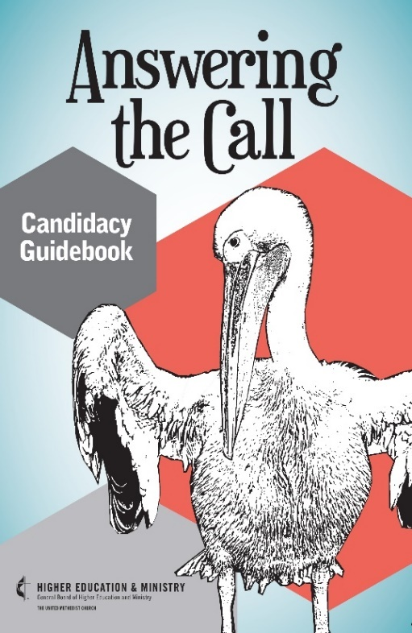
Candidacy Resources
The Christian As Minister, 2013 Edition
English and Spanish Editions Available
Part I – Discernment, UM Beliefs, Spiritual Disciplines
Part II – Making Decisions and Process
Appendices – Mentor Meeting Guides, Steps, Candidacy Retreats
New Chapters – Health and Wholeness, Financial Literacy
Spanish translation in the works

Slide 17
Licensing

Slide 18
Process and Requirements
¶ 315 and ¶ 316 – Licensing
¶ 317 – ¶ 320 – Other Licensing issues
Licensing School
License renewal – ¶ 319
Course of Study – ¶ 319
Related Disciplinary changes
Votes and interview timelines
Transcript evaluation

Slide 19
Transcript Evaluation
Requested through a BOM officer or the District Superintendent
Send request to cosregistrar@gbhem.org
Full policy posted in the resource section

Slide 20
Preparing for Licensing
Know the process for licensing and appointments
Evaluate prior education and transcripts
Policy for reading and writing assessment
TABE if needed
Learning differences
Language proficiency

Slide 21
While Appointed
LPs are clergy, not candidates
License renewed annually beginning with dCOM
Approved but not appointed means status is lay
Listed as certified candidates, or…
Approved but not appointed status on BAC
Course of Study participation
Course of Study exception for non-appointed candidates

Slide 22
Retired Local Pastors
Retired status requirements
Course of Study for Retired Local Pastors
Impending retirement does not preclude an LP from attending COS

Slide 23
Supporting Local Pastors
Theological education and formation
Clergy mentoring
Financial support and tutoring
Recognize COS completion
Fellowship of Local Pastors and Associate Members
Resources for LPs who are not dominant in English

Slide 24
Local Pastor Resources
BOM Handbook – Chapters 11, 16
Course of Study Guidelines
National Fellowship of Associate Members and Local Pastors – www.nfamlp.org
www.gbhem.org/localpastors

Slide 25
Associate
Membership

Slide 26
Process and Requirements
¶ 321 and ¶ 322
Educational Requirements
Associate vs. Provisional Membership
Conference standards for Associate Membership
Related Disciplinary changes
Votes and interview timelines

Slide 27
Associate Membership Resources
BOM Handbook – Chapter 11
National Fellowship of Associate Members and Local Pastors – www.nfamlp.org

Slide 28
Provisional
Membership

Slide 29
Process and Requirements
¶ 324
Medical Form
Educational requirements
Graduate education route
Course of Study route
Conference standards for Provisional Membership
Related Disciplinary changes
Votes and interview timelines

Slide 30
Provisional Membership Resources
BOM Handbook – Chapter 12

Slide 31
Resources
www.bomlibrary.org
District Committee on Ordained Ministry Section

Slide 32
Card Decks for Sale
E-mail to place orders being sent or send me an email
Cost - $11/deck, $7.50 S&H for order
Orders due to Candidacy Office by January 20
Estimated delivery by mid-February

Slide 33
Questions?
www.bomlibrary.org
District Committee on Ordained Ministry Section

Slide 34
Training the District Committee on Ordained Ministry
www.bomlibrary.org
Rev. Meg Lassiat
Executive Director of Candidacy and Conference Relations
mlassiat@gbhem.org
Rev. Shannon Conklin-Miller
Assistant General Secretary for Clergy Formation
sconklin-miller@gbhem.org

