Slide 1
Deacons Appointed Beyond the Local Church
Credentialing & Deploying

Slide 2
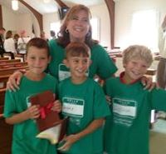
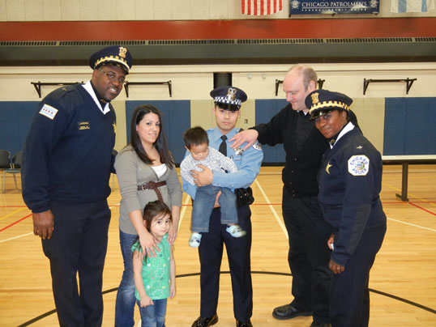
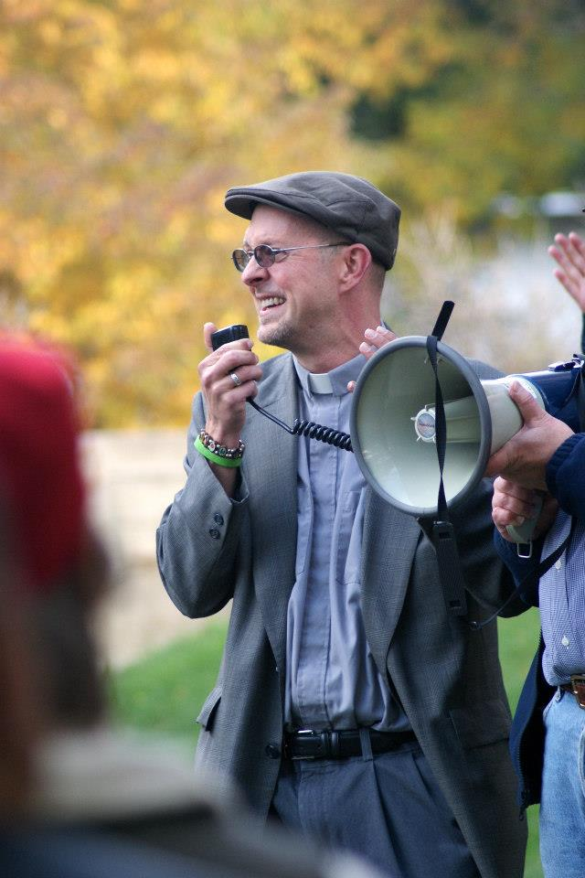
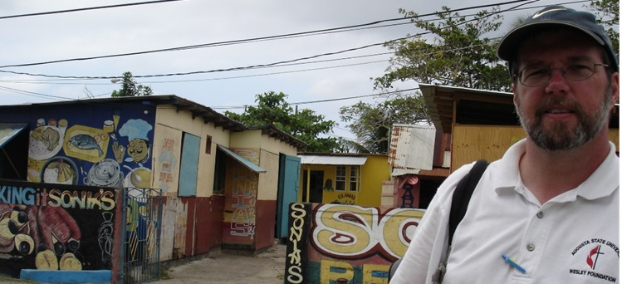
First Category of Appointment: Beyond the Local Church
Notes:
Deacons are appointed to connect the faith community to the needs of the world, especially those who are marginalized, poor, neglected.
The first appointment categories listed are outside the local church. About 40 percent of deacons are appointed beyond the local church.
They can be appointed to:
Agencies and settings beyond the local church, including ecumenical agencies, that extend Christ’s love and justice in the world and connect church to those in need
UMC agencies, schools, connectional structures
A congregation, charge, or cooperative parish
Attend school
Self-employed in a setting that has a body that helps with goals, evaluation, an accountability acceptable to the bishop, cabinet, and BOM.

Slide 3
advocate lead justice empower invite train compassion Bridge encourage justice pray worship invite support discern lead serve empower assist train preach Advocate lead empower justice invite assist train compassion Bridge encourage justice pray invite worship support discern lead serve empower train preach invite Advocate lead justice empower preach invite train compassion Bridge encourage justice pray invite worship support discern lead serve empower train Advocate lead justice empower invite train compassion encourage justice pray invite worship support discern truth serve empower organize train preach Advocate lead justice discern empower invite Bridge train compassion Bridge pray encourage justice pray invite worship support discern lead serve empower train preach assist
Notes:
Whether elder or deacon, ordained clergy are responsible not only for the ways they advocate for justice and offer compassion, but for the ways they lead other baptized Christians into these baptismal vows.
For deacons, it’s a 2,000 year old ministry. Word has the literal meaning of “servant” and in usage also had the meaning of “emissary.”
Deacons and bishops are the first offices mentioned in the NT (Phil 1:1, Rom 16:1, 1 Tim. 3:8-13). Deacons and bishops are mentioned together and in the early centuries of the church, they worked closely together.
99-399 called “The Golden Age of the Diaconate.” Church leadership is three-fold: bishops, presbyters, and deacons
Number of deacons increased significantly
Importance enhanced
Functions more clearly delineated
Deacons had close relationship to the bishop, performed certain administrative and liturgical functions, led the church’s ministry in caring for the poor, collecting and distributing the church’s offerings for the poor, visiting the sick
Some deacons presided over the Eucharist or baptized with the bishop’s authorization, when neither bishop nor presbyter was able to be present. In some cases, deacons were in charge of small congregations.
Late fourth century (post-Nicene): Hierarchical Ordering
Church started to restructure similar to Roman government. Bishop became regional. Presbyters became priests. Deacon became stepping stone “up” to presbyter and then up to bishop; an apprentice to the “higher” role of priest. Diaconate waned with this reduction in “status.” Celibacy became expected of clergy; why agree to celibacy for a less respected order? Monastic orders took on the social service ministry once led by deacons. Deacons could administer communion or baptize in grave or urgent circumstances. 18th-19th Centuries:
Urbanization led to rise of social work and settlement house movement as well as orders of deaconesses who served the poor. Europe sees a flourishing of diaconal houses of ministry that served the poor, including founding schools and hospitals. European deaconesses live communally in motherhouses and serve as nurses, social workers, and parish workers. In 1888, Methodist Episcopal Church General Conference approves creation of the lay office of deaconess. Women’s organization oversees this. Jane Bancroft Robinson and Lucy Rider Meyer led the movement, inspired partly by the European movement.
20th-21st centuries
1964: World Council of Churches holds a consultation on the diaconate. Several churches expressed interest in a permanent, service-oriented diaconate.
1965: Second Vatican Council establishes a permanent clergy diaconate (for men) in the Catholic Church.
1976:United Methodist General Conference creates office of diaconal minister, for laypeople who are called to be employed by church or outside agency, consecrated for specialized ministries of love, justice, and service. Most who were consecrated were church workers in Christian education, youth ministry, music, and church business administration.
1989: Methodist Church in England restores a permanent, service-oriented, ordained diaconate.
1996: United Methodist General Conference approves two ordained orders, deacon and elder;
direct ordination to both.
2008: General Conference allows bishops to authorize a deacon to administer the sacraments when no elder is available, within a deacon’s primary appointment.
2016: General Conference adjusts deacons’ administration of the sacraments to be determined by bishop and deacon “for the sake of extending the mission and ministry of the church.” No DS or elder permission/absence required.

Slide 4
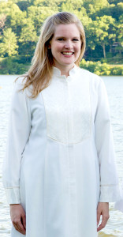
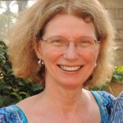
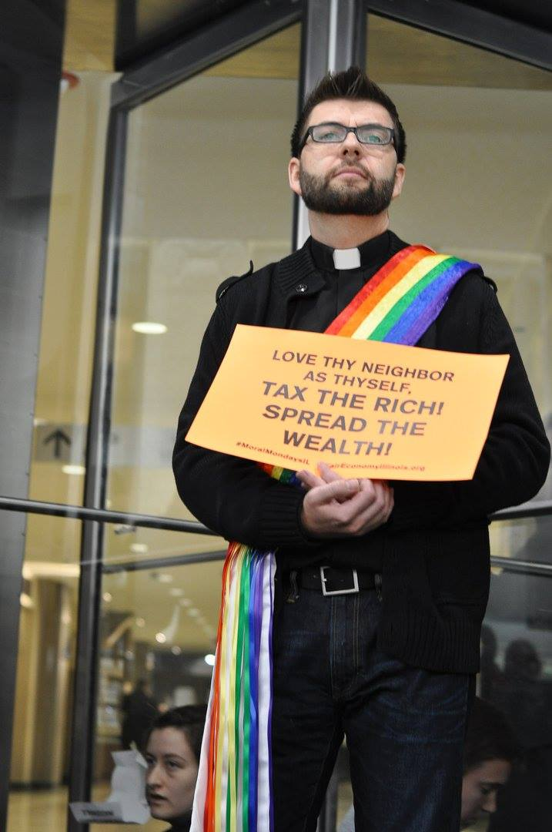
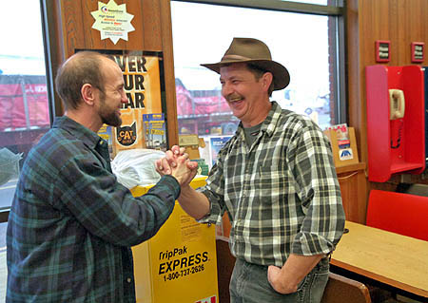
Connecting Church and World
Notes:
Whether elder or deacon, ordained clergy are responsible not only for the ways they advocate for justice and offer compassion, but for the ways they lead other baptized Christians into these baptismal vows.
For deacons, it’s a 2,000 year old ministry. [need some brief history]
Meredith Martin (far left), director of programs at Family Services of Davidson County, N.C. She has a master of divinity and a master’s of social work. The agency works with people in our community who are experiencing challenges in their lives due to mental health problems, involvement in the criminal justice system, domestic violence and/or sexual assault and related risk factors. “Through my work I connect with local churches to provide volunteer opportunities for churches, training for clergy and their congregations, community presentations, and I also do some consulting with pastors and other faith leaders on issues they are facing in their churches and how to appropriately handle them. Currently, I am doing a lot of training for faith leaders on how to respond when persons in their communities share they are experiencing domestic violence.”
Gregory Gross (far right), director of The Night Ministry, in Chicago, which provides housing health care and human connection to those experiencing poverty, housing instability, or hopelessness. He also actively advocates (and invites others into that work of advocacy) for public policy change in Illinois on behalf of the poor.
Amelia Boomershine (next to Greg) operates “Seeds of Grace,” a ministry to incarcerated women in Dayton. They help incarcerated women encouraged Bible stories, learn to tell their own stories, learn spiritual practices, and connect with advocates on the outside who will help them with the job and housing process once they are released . . . and to continue in their spiritual disciplines. Laypeople are part of this ministry, supporting the women in prayer and serving as mentor/friends as they readjust to life after incarceration.
Bruce Maxwell (lower photo) is a chaplain at Breezewood Trucker/Traveler Minsitry in Pennsyvlvania. He offers prayer, counsel, hospitality and emergency help at two Pennsylvania truck stops. He provides a listening ear, provides Bible and spiritual growth recordings for the long trips on the road, helps people with emergency needs. The trucker’s life is a solitary one, and Bruce helps them with strengthen relationships.

Slide 5
Approving Self-Employment Settings
Ministries of Word, Service, Compassion & Justice
Relationship & accountability with the Order of Deacons & church structures (conference, etc.)
Accountability & support (board, church, etc.)
Represents the church’s ministry to the world
Financial well-being
Gifts, training, education, and work experience
Notes:
Self-directed ministries
Appointments beyond the local church need to have a body that helps with goals, evaluation, an accountability acceptable to the bishop, cabinet, and BOM. This can be provided by a church that has a relationship to the ministry. Or it can be provided by a small board of directors. A performance evaluation based on goals should be submitted annually with the deacon’s annual report to the annual and charge conference.
The BOM and bishop assess whether a proposed setting is appropriate as an appointment for a deacon. GBHEM offers these questions to help BOMs and bishops:
• How is the proposed ministry one in which the vows of ordination to Word, Service, Compassion and Justice can be fulfilled?
• How does the proposed ministry setting provide an opportunity to maintain a relationship and accountability with the Order of Deacons and the structure of the church?
• How is the proposed ministry congruent with the church’s commitment into the world?
• Does the person possess the gifts, training, education, and work experience required for the proposed ministry?

Slide 6
Certification Specialized Ministry
www.gbhem.org/certification
Available to clergy and lay
Demonstrates person has been called, trained, and is accountable to their annual conference for practice in a specialized ministry
GBHEM
Sets standards for education
confirms the student has met the education standards
Conference BOM
Interviews, background checks, psych evaluations, references
Approves for certification
Maintains certification records, including renewals

Slide 7
“Alternative ministries are what are going to help the church grow.”--Wanda Stahl
Bringing the Good News to the world/partnership in establishing the realm of God
Inviting people to the faith community
Sending disciples out to minister in the world
Expand the faith community to represent the body of Christ

