Slide 1
The Ministry of the Licensed Local Pastor

Slide 2
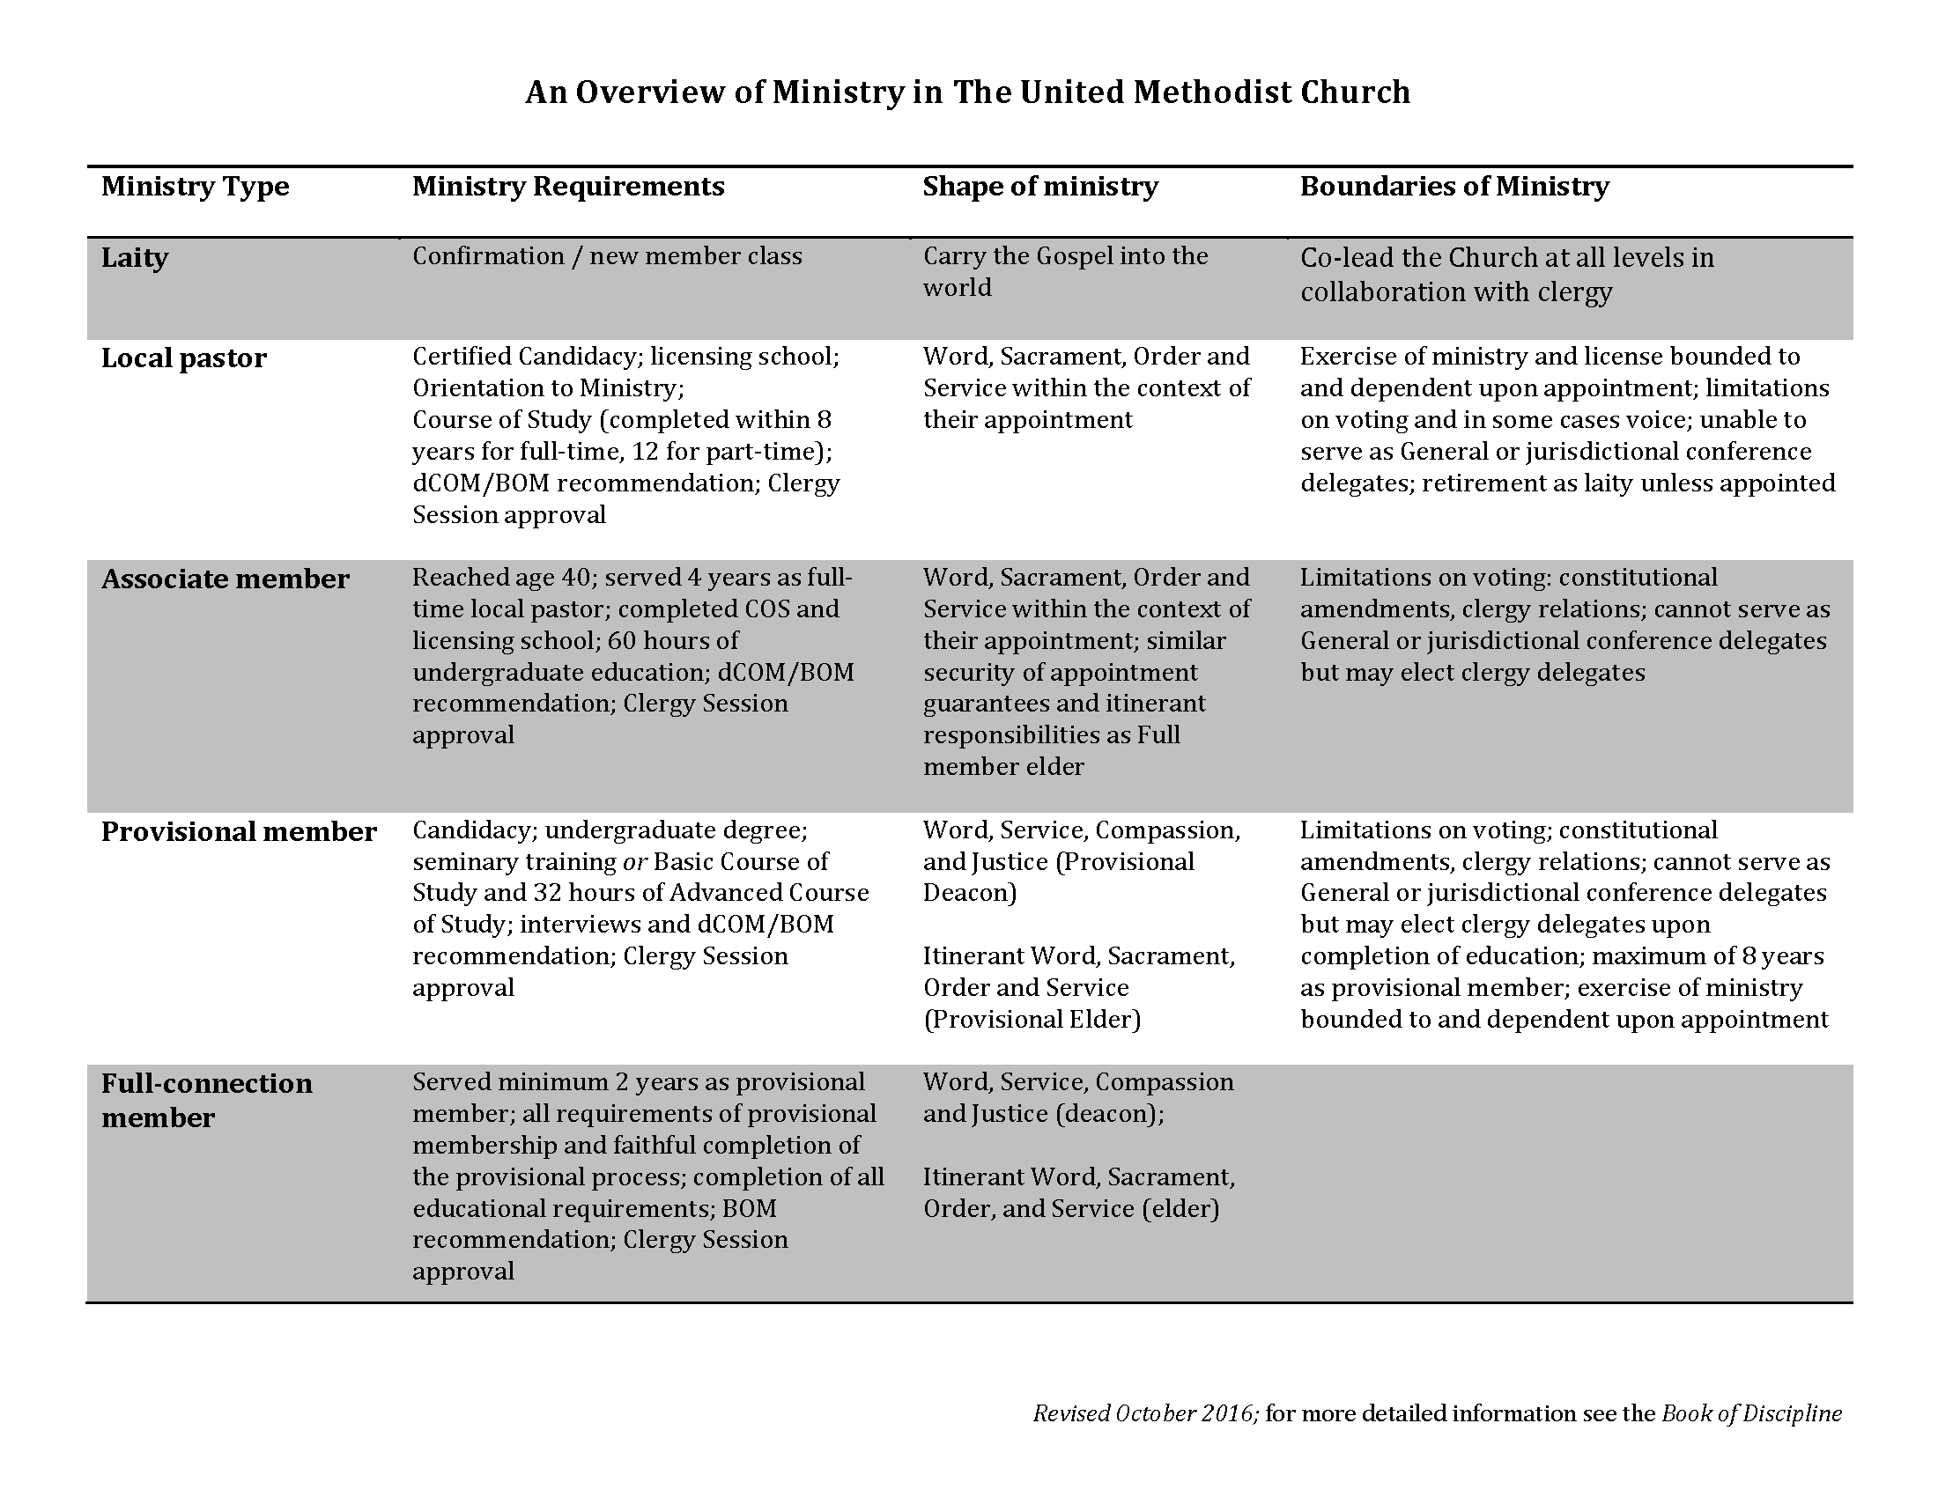

Slide 3
Number of Local Pastors:
2012-2016: Conference increased LLPs: 29 of 56 (52%)
Conference decreased LLPs: 26 of 56 (46%)
Conference LLPs stayed the same: 1 of 56 (2%)
2015-2016: Conference increased LLPs: 23 of 56 (41%)
Conference decreased LLPs: 29 of 56 (52%)
Conference LLPs stayed the same: 4 of 56 ( 7%)
Data from the Lewis Center for Church Leadership report on young clergy trends

Slide 4
Prior to appointment as a Licensed Local Pastor:
Certified Candidacy
Licensing School (80 hours; BOM designs and administrates based on curriculum from GBHEM)
Have policy for assessment of reading and writing capabilities; TABE—assesses writing and math levels; can be obtained through GBHEM

Slide 5
Recommendation of BOM to Clergy Session
Clergy Session approval
Appointed by the Bishop
When under appointment, LLPs are no longer listed as certified candidates; they are clergy.
When not under appointment, LLPs are laity. They can resume their Certified Candidacy or be in “approved but not appointed” status.

Slide 6
Annual Meeting with dCOM; license renewed annually
Must be assigned a mentor while in the Course of Study
Can retire as a local pastor if has made “satisfactory progress” in the COS
Retired LLPs who have completed the COS can be given sacramental authority at the church where they are a member

Slide 7
Associate Members
Are itinerant
Security of appointment
Can vote on all matters except constitutional amendments and clergy matters
Can serve on any committee or board, but cannot be delegates

Slide 8
Recommended by dCOM and approved by clergy session
Prepare at least one written sermon on passage selected by BOM
Satisfactory written doctrinal exam
Can become provisional members if fulfill provisional requirements

Slide 9
Ways to Support LLPs:
Emphasize the importance of theological education and formation
Provide required mentor;
Provide financial support for COS, and tutoring if needed;
Recognize completion of COS at Annual Conference;
Develop strong Fellowship of Associate Members and Local Pastors

Slide 10
Fellowship of Associate Members and Local Pastors
Convened by the Bishop
Chair can be full-time or part-time, but must have completed the COS
Chair of Fellowship is on the Board of Ordained Ministry
Most effective when there are strong connections between the Orders and the Fellowship
National organization: (www.nfamlp.org )

Slide 11
Issues and concerns:
Supply pastors—should be in candidacy process after 1 year (or working to be CLM)
Balance of work/life issues, especially for bi-vocational pastors
Racial Ethnic pastors, dominant in languages other than English pastors—need focused and sustained support, networking, and resourcing
Ordination as local elder (Ministry Study discussed but did not pursue)

