Slide 1
Effective Ministry 360 Candidacy Process Preview
Notes:
Have everyone type into the comments their annual conference, visible to everyone
Reminder that we need all summit dates

Slide 2
What is the EM360?
A mechanism for reflecting on effectiveness and developmental needs, and for providing candidates and annual conferences resources to support candidates in meeting their mission and ministry goals. The goals are to help the candidate identify areas of strength and areas of needed growth so that the candidacy process may become a time of preparation and growth toward effectiveness in ministry.
Notes:
EM360 is a tool used to identify what gifts, strengths, areas for development, and attributes the candidate demonstrate as they begin the application process for certified candidacy.

Slide 3
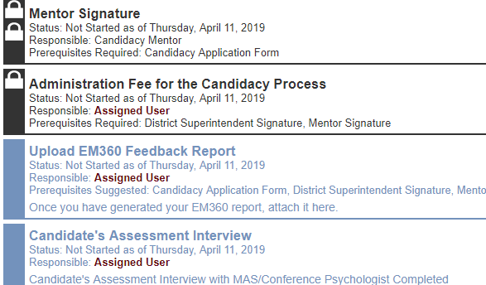
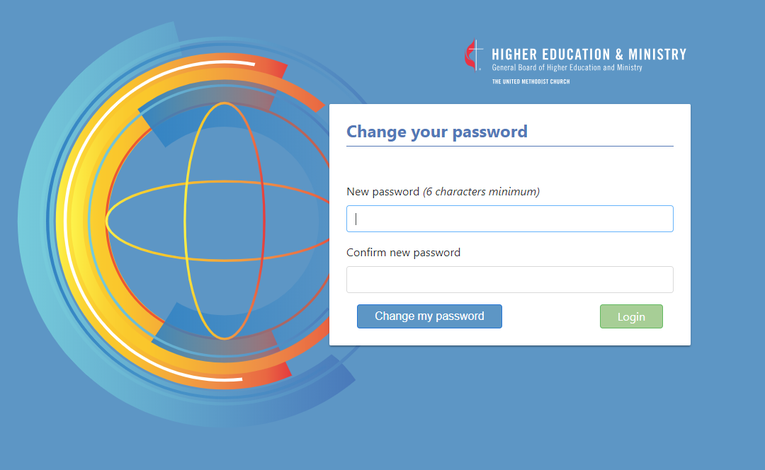
How will this affect the current candidacy process?
All candidates in UMCARES will complete the EM360 as part of their candidacy process.
Starting in May all candidates who have not completed the Candidate’s Assessment Interview step will have the “Upload EM360 Feedback Report” step added to their candidacy track.
Notes:
We are working out the details to make sure that candidates who are past the assessment interview are not required to complete the EM360 step.

Slide 4
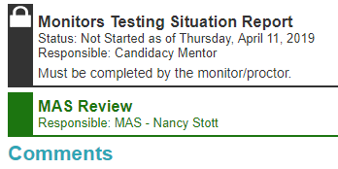
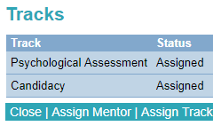
How does this affect psychological assessment?
EM360 will replace the Personal/Professional references step in UMCARES
Ministerial Assessment Specialists will receive a copy of the feedback report as part of the GBHEM battery
Conferences who do not use GBHEM for psych assessment are encouraged to share this feedback report with their MAS.
Notes:
The MAS interpretation guide will be provided to all MASs not just those who use GBHEM’s battery
The EM360 does not need to be proctored. It can be completed before the psychological assessment battery is completed
GBHEM psychological assessment tracks will not be marked complete until the EM360 feedback report is uploaded into the candidacy track
This does not apply to non-trad/retake tracks

Slide 5
How are candidates added to the EM360?
Candidates are added to the EM360 platform after they are entered into UMCARES by the Clergy Excellence Office on a weekly basis.
Instructions for the candidate on how to access their dashboard are included in the Assist Files on the Upload EM360 Feedback Report step in UMCARES.
Available resources in the assist files include:
A link to the “Getting Started” video
The Candidacy quick start guide with step-by-step instructions and a link to the setup page
A direct link to login page
Notes:
EM360 is completed on a different webpage.
To get started they will open the Upload EM360 Feedback Report step
Access the assist files
Demonstrate how they will access the EM360 the first time
Show them in the test server the step

Slide 6
To get to the EM360 portal, Candidates can click on the EM360 Access Link

Slide 7
Candidates will click Get Started to begin

Slide 8
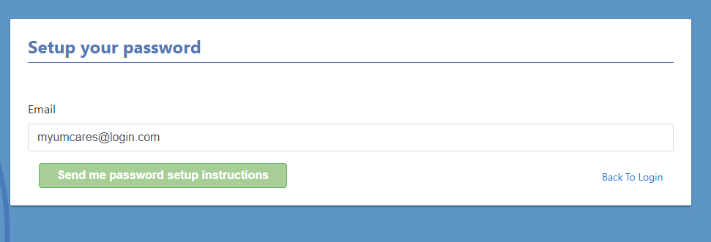
Then enter in their email address and click Send me password setup instructions
And go to their email

Slide 9
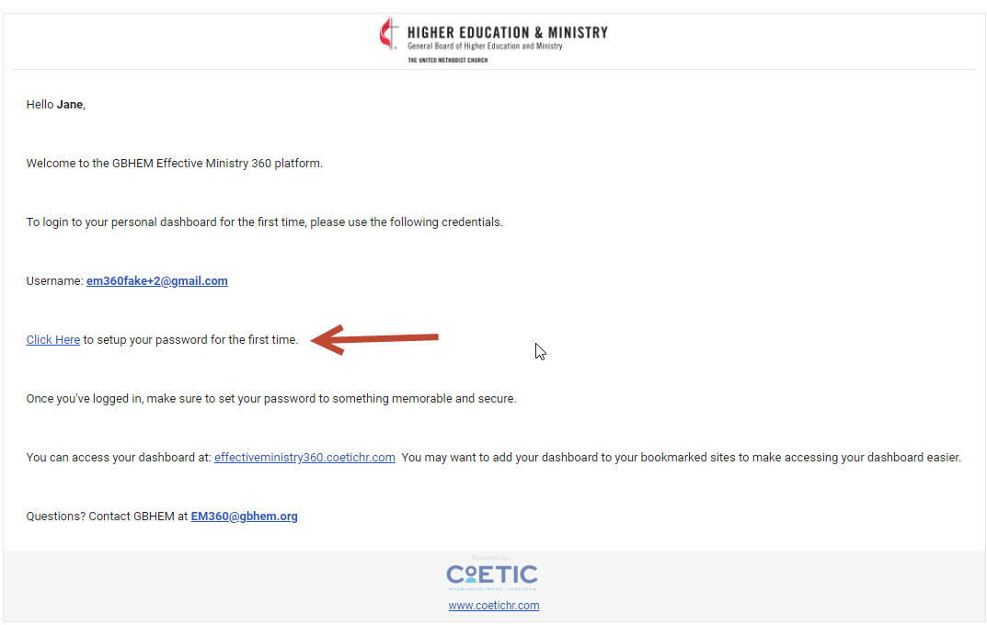
Candidate will open the “Welcome to your Effective Ministry 360 Dashboard” email and click on the link to setup their password.

Slide 10
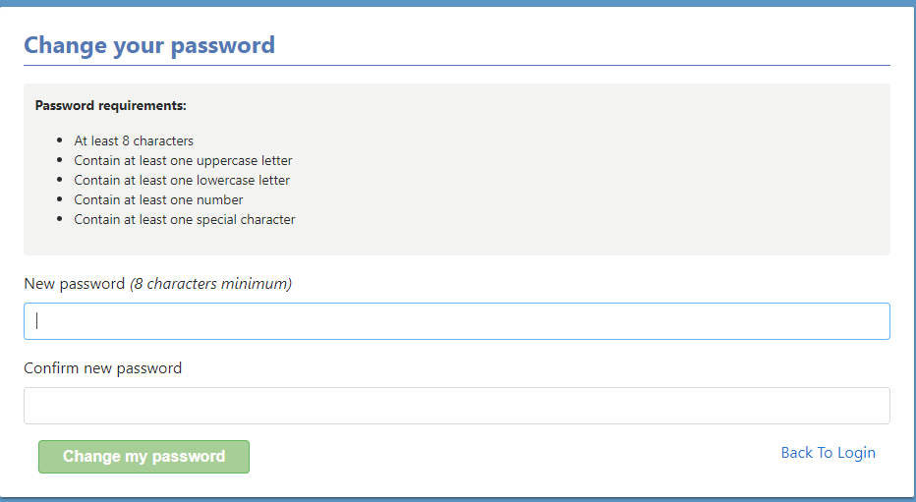
Candidates will then set up their password and click Change my password

Slide 11
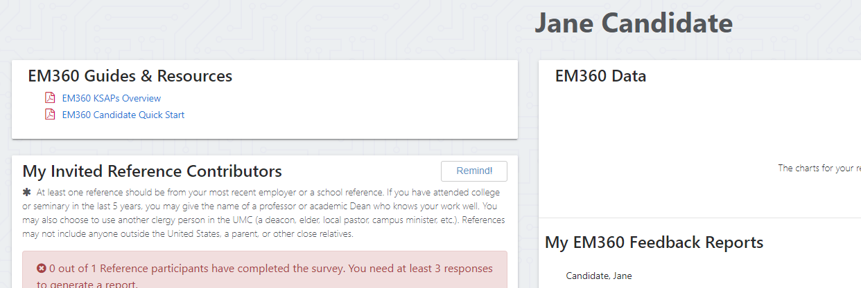
This will take the candidate to their dashboard.

Slide 12
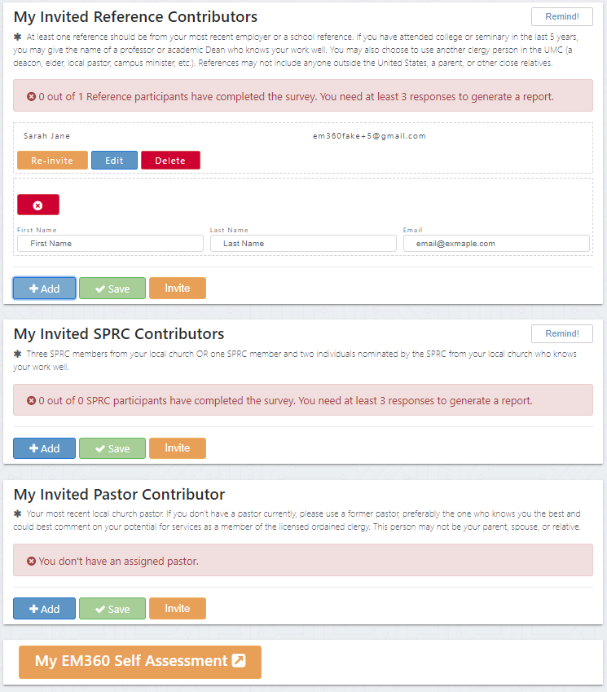
How do candidates complete their EM360
The candidates will invite all their contributors by adding them into their dashboards and clicking invite.

Slide 13
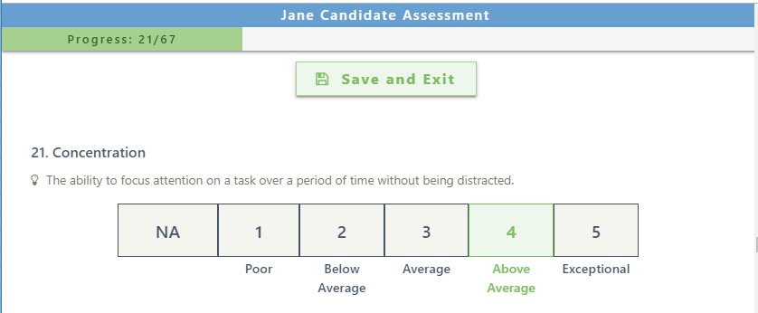
Then the candidate will take their self-assessment. If a candidate needs to stop while working through the assessment they can click Save and Exit and return at a later time. If the survey accidentally closes their progress will be auto-saved.

Slide 14
The counters at the top of each contributor type box will let the candidate know when they have enough responses

Slide 15
Once enough responses are received, candidates can generate their report by clicking on Generate Report

Slide 16
My EM360 Feedback Reports
Feedback reports can be downloaded directly from the candidate dashboard

Slide 17
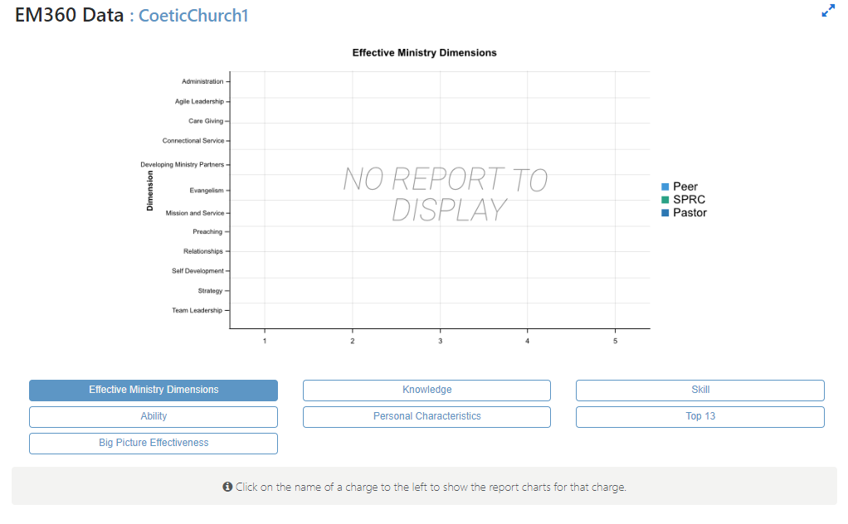
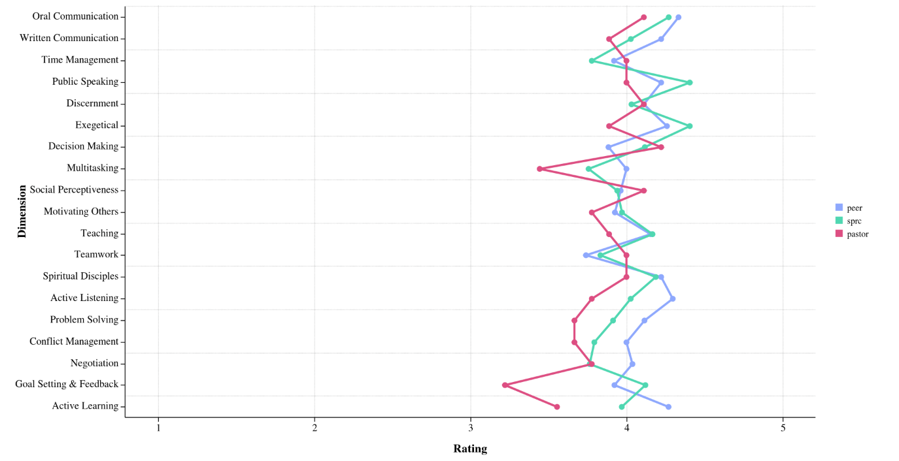
EM360 Data
Candidates can view their EM360 data on interactive charts

Slide 18
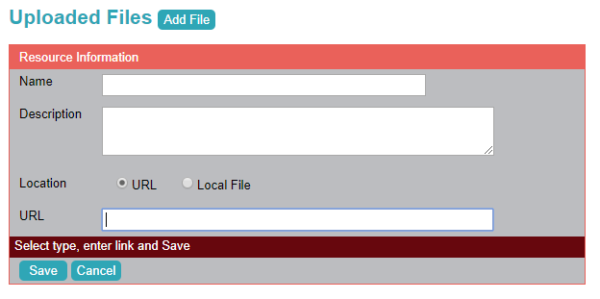
Finally candidates upload their feedback report into UMCARES

Slide 19
Questions? Contact Us: EM360@gbhem.org Find more information at: www.GBHEM.org/EM360
Notes:
Talk briefly about administrator view

