Slide 1

Psychological Assessment FAQ
What assessments do I complete and what is the order?
  The MMPI-2 using the Qglobal link provided by your proctor
  The Incomplete Sentences Blank in UMCARES
  The 16PF using the tara.vitapowered link provided by your proctor
Can I listen to music while completing my assessment?
  Yes, listening to music is permitted while working on your assessments but it will need to be noted on your Testing Situation Report
Can I use my phone as a translator?
  Using a translation service is not advised, if you need assistance in interpretation please let your proctor know
What other factors might affect the results that I should tell the proctor?
  if you experienced a traumatic event or any kind of changes in your personal or professional lives recent to the Assessment
  environmental factors that affected your concentration, such as the room being too hot, too cold, or too noisy
Notes:
Glad you’re here.

Slide 2
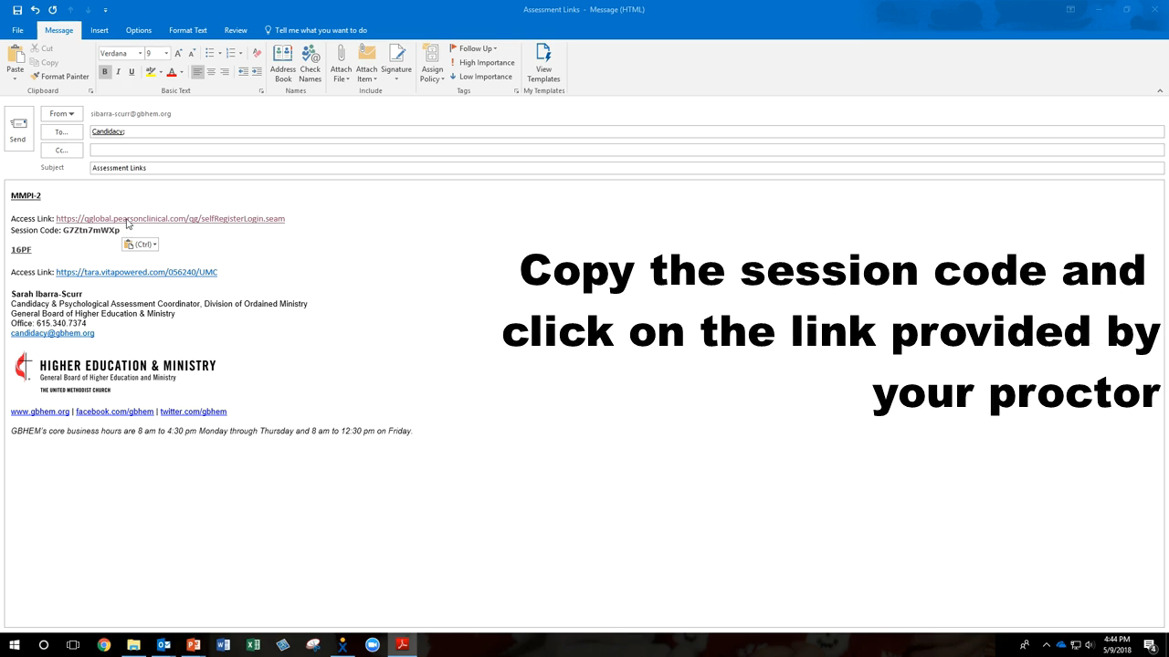
MMPI-2
Notes:
Glad you’re here.

Slide 3
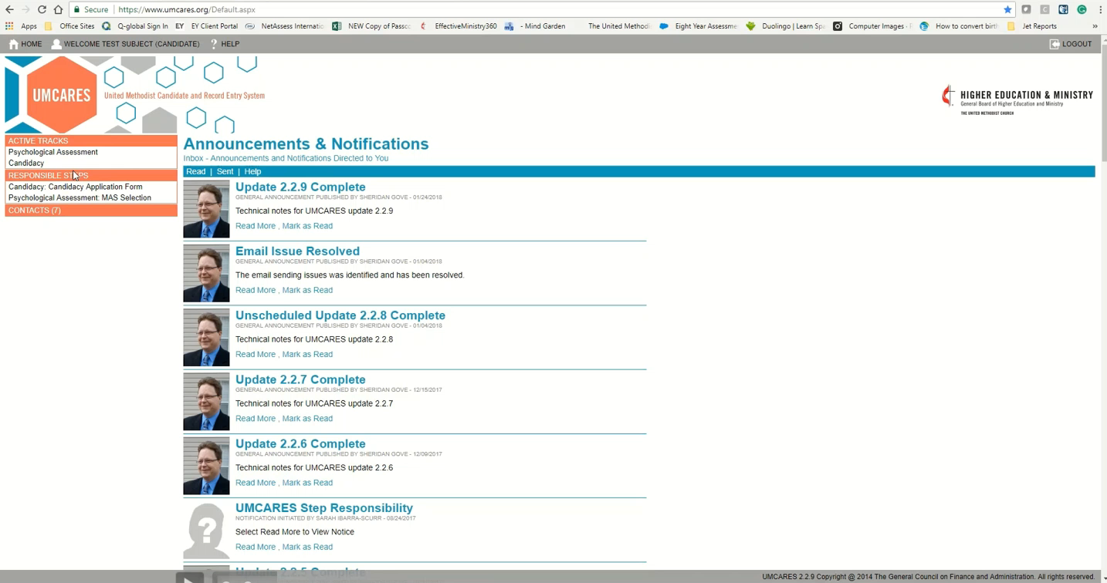
Incomplete Sentences Blank
Notes:
Glad you’re here.

Slide 4
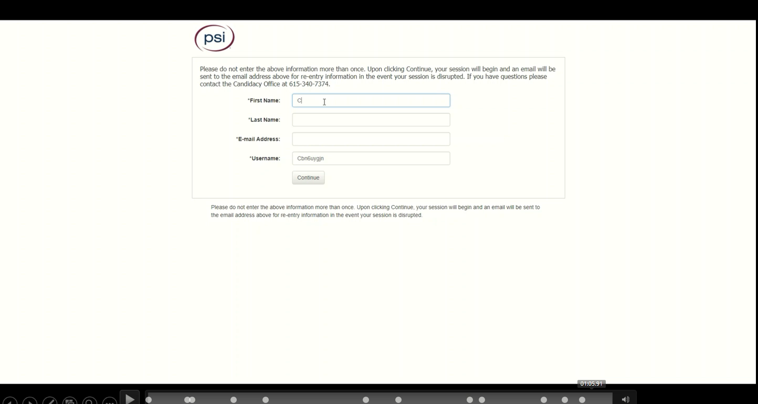
16 Personality Factor
Notes:
Glad you’re here.

