Slide 1
Psychological Assessment
Digital Conversion

Slide 2
The Big Picture
Candidates will complete the entire psychological assessment battery provided by GBHEM online.
New look for the MAS Review portal
No more mailed assessment packets

Slide 3
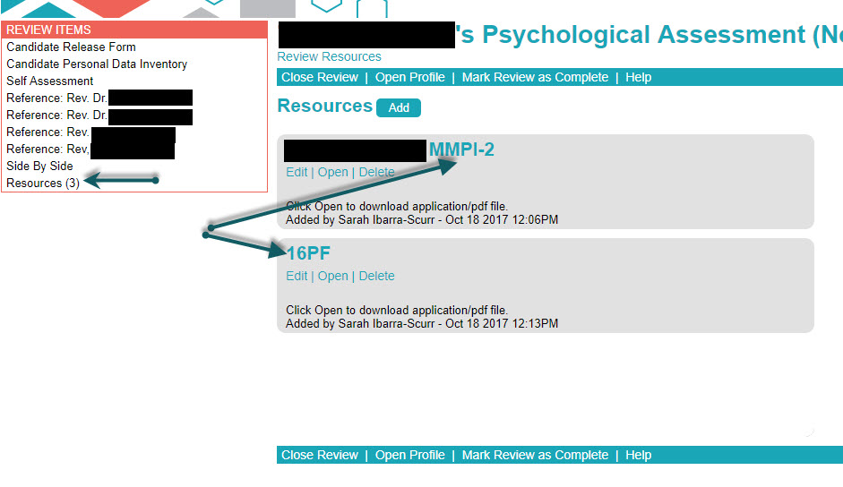
Digital Psychological Battery
MMPI-2 now completed online, scantron forms already in circulation can be completed and scored
Reports for the MMPI-2 and 16PF will be uploaded into the Resources section of the MAS Review portal

Slide 4
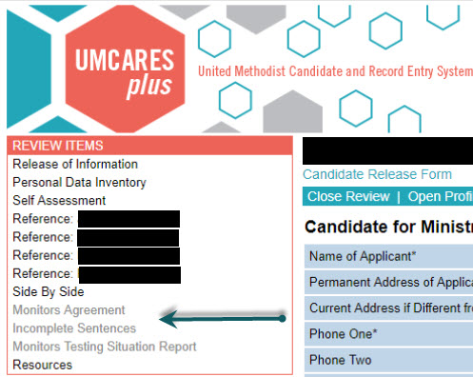
Digital Psychological Battery cont.
Incomplete Sentences Blank, Monitor’s Agreement, and Monitor’s Testing Situation Report are forms within UMCARES
They are accessed on the Review Items menu

Slide 5
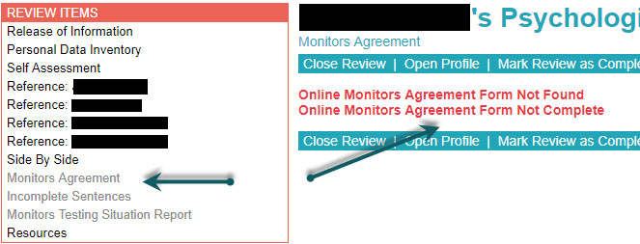
New Review Look
All items to be completed as part of the psychological assessment will be listed in the Review Items Menu
Grey items are not complete
If a form has not been started and is opened an error message “Form Not Found” will appear
If a form is started but not submitted an error message “Form Not Complete” will appear

