Slide 1
UMCARES
plus
Sheridan Gove Application Developer
Jodi Chadwell Chief Officer of Shared Services & Ministry Evaluation

Slide 2
Jodi Chadwell, Chief Officer of Shared Services
Sheridan Gove, GCFA Application Developer

Slide 3
What is UMCARES?
UMCARES allows candidates to progress through their candidacy process, allows others to assist and manage them along the way.
What is UMCARESplus?
UMCARESplus gives conferences access to the tools to create, manage and report on individuals beyond the candidacy process within the same application.

Slide 4
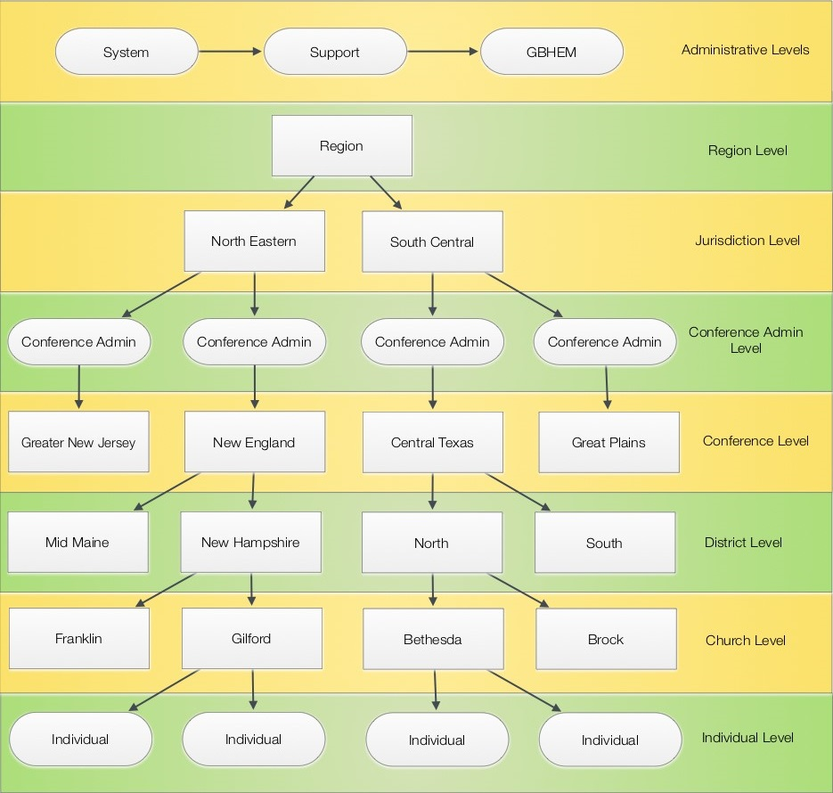
Security
Site SSL certification
One way encrypted passwords
Timed login lockouts to help prevent against hacking
In system profile access based on interrelationship between location, access & permissions

Slide 5
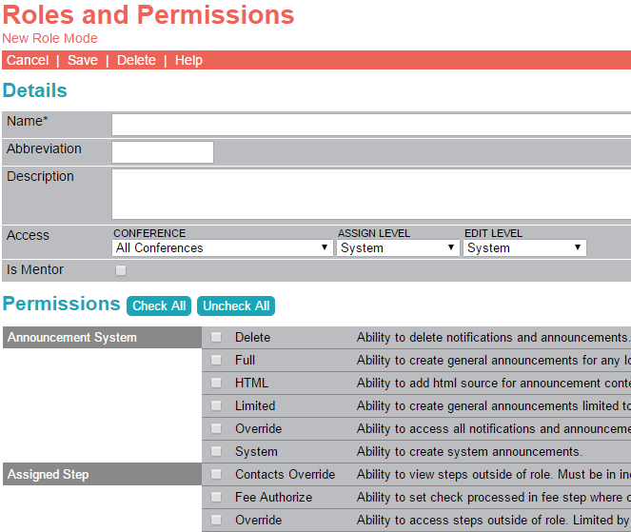
Roles
Roles store application based permissions.
Role(s) are then assigned to users in the system.
Select from:
Application shared roles
GBHEM designed roles
Your own customized roles

Slide 6
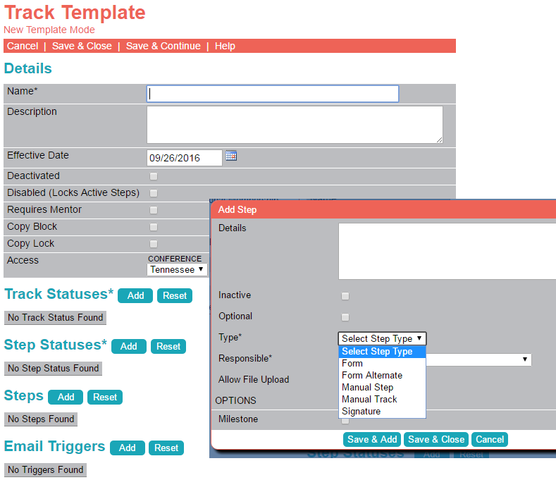
Tracks
and Steps
Customize your own tracks to assign users.
Copy shared tracks
Track syncing
Custom track & step status
Custom steps to track sign off or collect form data
Custom status triggers

Slide 7
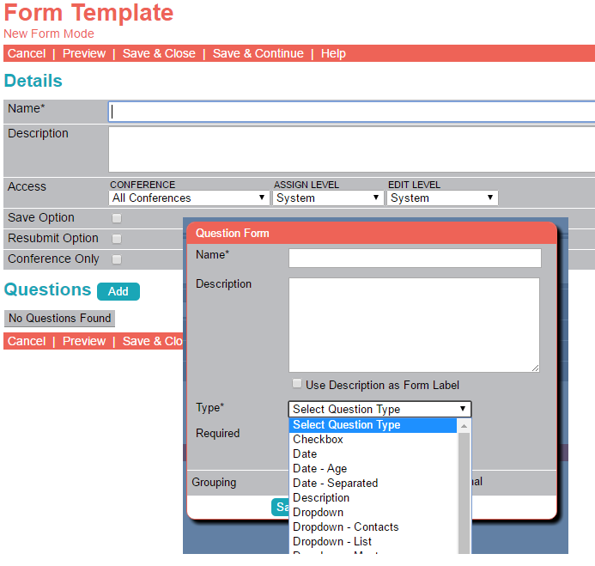
Forms and Questions
Customize forms, assign to steps, assign track and begin collecting reportable data.
Copy shared forms
Linear or inline forms
Sub forms for relational data collection
Variety of question types including encrypted fields

Slide 8
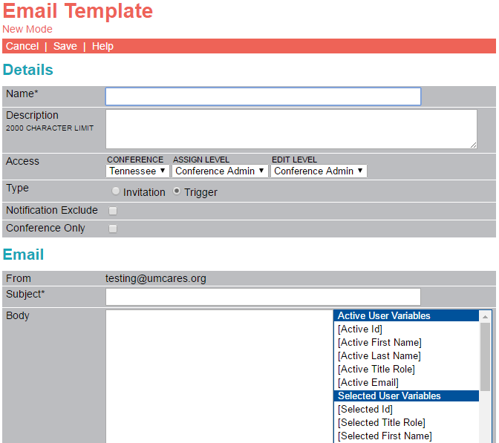
Emails
Customize emails for
User invitations
Track and step triggers

Slide 9
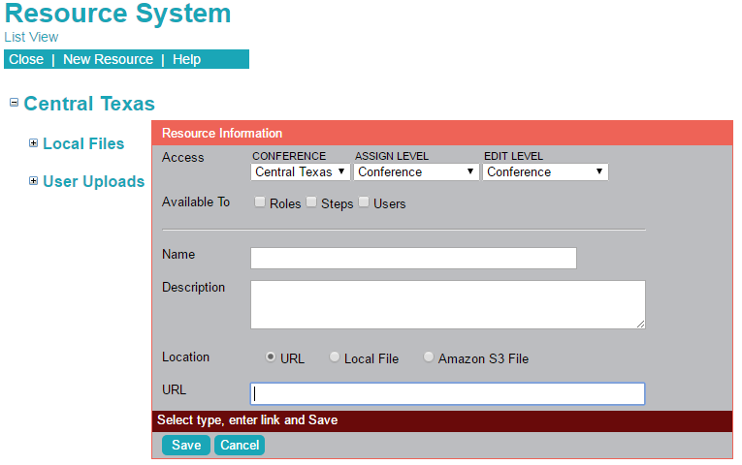
Resources
Resources can be files or links that assist users.
Store files locally or amazon s3*
Link to URL or video
Assign resource to roles, steps or directly to a profile
Steps can also allow users to upload, or link, their own resources.
25GB of free local storage provided and stored on GCFA servers.
Amazon S3 requires separate amazon account maintained by conference.

Slide 10
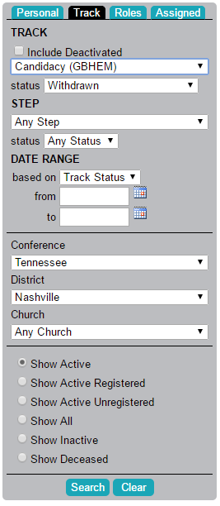
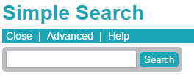
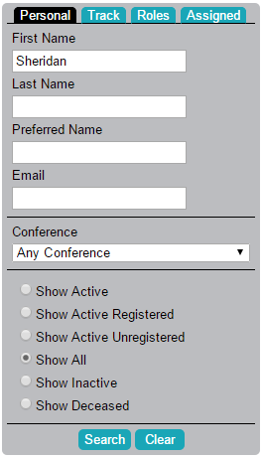
Search
Included in UMCARES
Simple search
Advanced personal search
Track and status search
Role based searches
Assigned search to get quick list of users assigned to MAS or mentor
Exportable results
Color coded results to help determine account status.

Slide 11
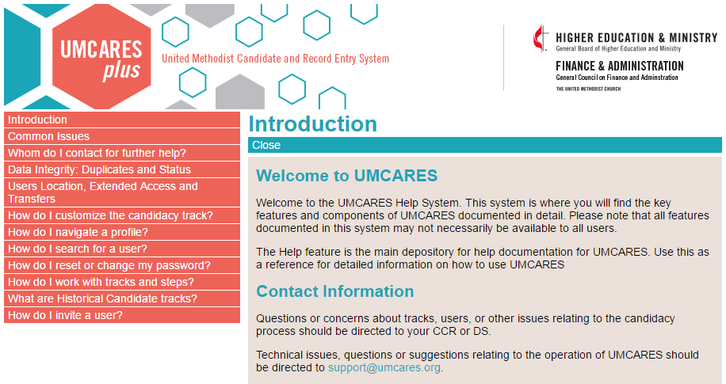
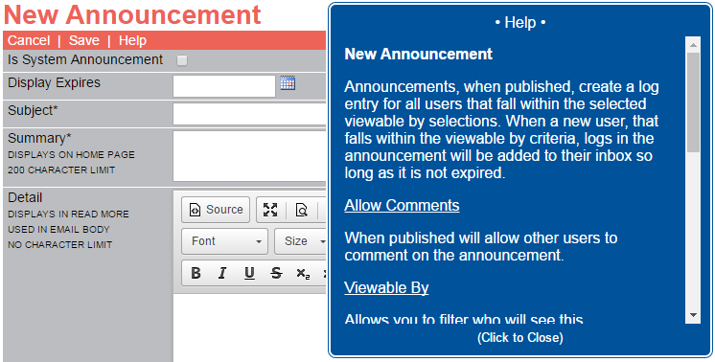
Included in UMCARES
Help System with a growing list of topics
Integrated page help specific to the page in use

Slide 12
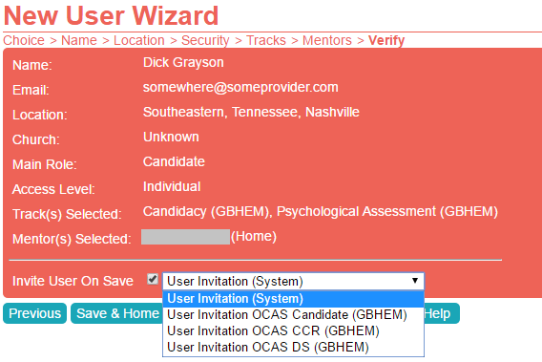
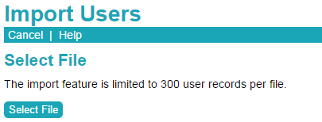
*Included in UMCARES
Mass User Import
Import up to 300 users from CSV file
Group assign access, location, roles, tracks and more
Import/update records review with data checks, color coded changes and hover over details
Progress report and exportable results
Create Individual Profiles*
Administrative or track based
Top 50 matches with quick links to profile

Slide 13
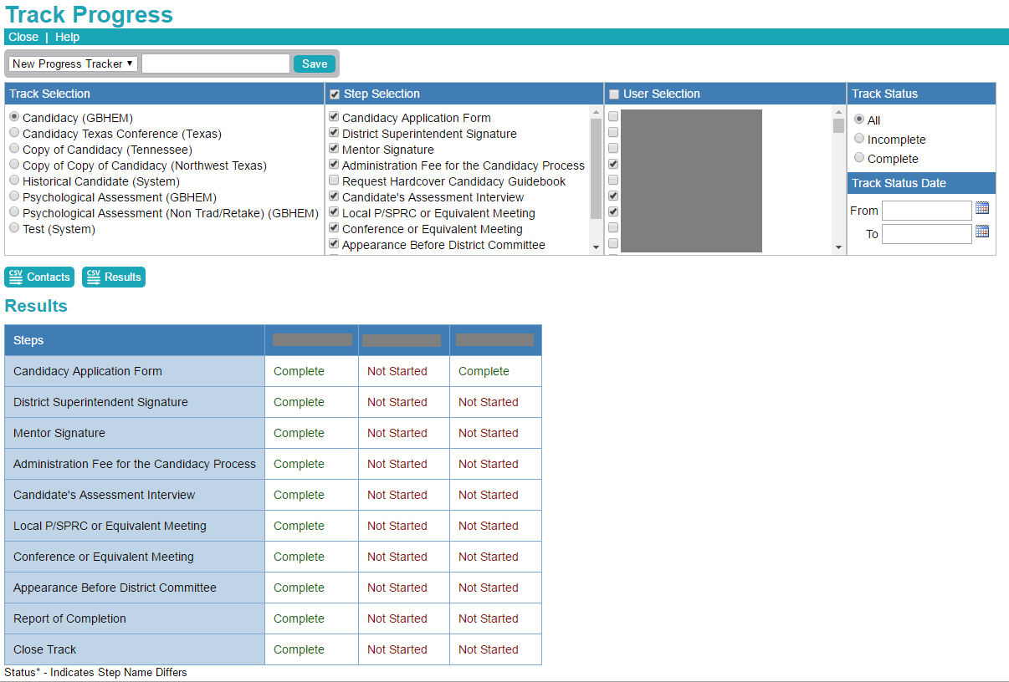
Track Progress
Quick look at select users step progress
Exportable contacts & results
Results with quick links to profiles and steps
Save search criteria

Slide 14
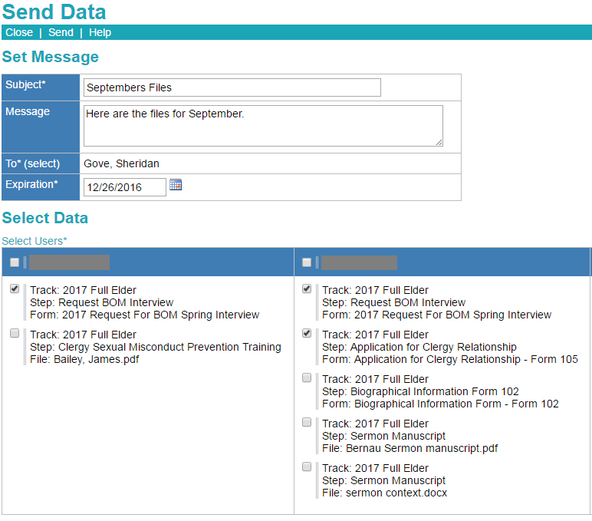
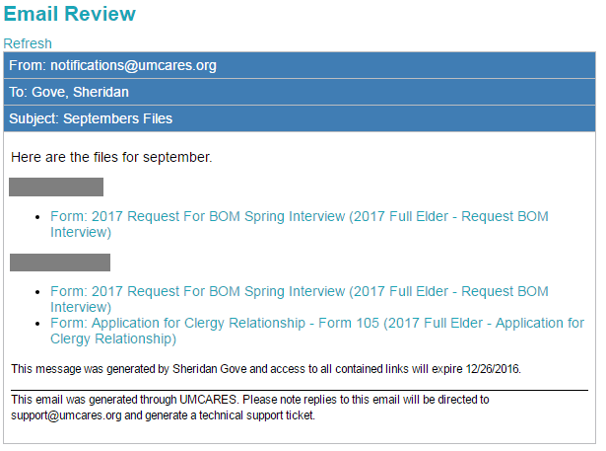
Send Data
Group and send user select forms and files for review by registered users in the system
Customizable email
Expirable links sent
Grouped lists of user forms and files
Select all or individual forms and files
Reviewable email

Slide 15
Professional Support
UMCARES was designed with you in mind
You have a voice into future development
Conferences using UMCARESplus receive:
Onboarding Support
Personalized Training
UMCARESplus is affordable!
Only $250/month
Onboarding available for only $300
Contact Shared Services for more Information!
SharedServices@gcfa.org

Slide 16
Thank You

