Slide 1
BOM Quadrennial Training 2016

Slide 2
The Big Picture
Candidate
Registrar
D.S.
dCOM
BOM
GBHEM-DOM
Local Church
Mentor
Education
Many relationships
Communication
Different responsibilities
Notes:
Registrar – Train, interpret, record keeping, liaison among all the parties – keep the wheels turning
Local Church – Identify candidates, approve entry and continue candidates from year to year
Mentor – Assist in discernment, reflection and growth, guide and counsel candidates about process mentor report to dCOM
DS – Approve entry into candidacy process, nominate mentors and dCOM members
dCOM – Enlist and approve applicants for certified candidacy, assign mentors, approve candidates for licensed ministry
BOM – Receive candidates from dCOM, interview and approve candidates for associate, provisional, and full membership
GBHEM-DOM – BOM/dCOM support and consultation; UMCARES; Psychological Assessment; Mentor/dCOM/BOM training
Education – Seminary and Course of Study depending on track; dCOM/BOM needs to receive annual transcripts

Slide 3
Candidacy Registrar Job Description
Process
Files
Liaison
Provide Resources
UMCARES
Psychological Assessment
Education

Slide 4
The District Committee on Ordained Ministry ¶ 666
Sub-committee of the BOM (¶ 666.1)
Representative from each dCOM on the BOM (¶ 635.1g)
Approves candidacy and licensing for all persons (¶ 666.6)
New decisions from General Conference
¶ 666.1 – The District Superintendent shall not chair the dCOM
¶ 666.4 – The dCOM required to make reasonable accommodation for cultural and ethnic/racial realities and language translations (see also ¶ 310.2b)(2)).
Lay Supply - ¶ 205.4 – If a lay assignment will last longer than one year that person must enter the CLM or certified candidacy process

Slide 5
Fitness/Potential, Readiness, and Effectiveness
Certified Candidacy
Fitness/Potential
Provisional Membership & License
Readiness to Serve
Full Membership & Continuing License
Effectiveness in Ministry

Slide 6
Mentoring
Ministry of All Christians
Grace
Gifts
Fruit

Slide 7
Group Mentoring
Why?
Candidates requesting more consistency
Candidates seeking desire to share process with other candidates
Demonstrating success in Provisional Membership Groups
Conferences wanting fewer mentors and gifted mentors
Conferences wanting to streamline process
Benefits
Creates setting where candidates can focus on discernment, not just application
One central contact person
Candidates receive consistent, identical information
Timing and requirements of process are standardized across the conference

Slide 8
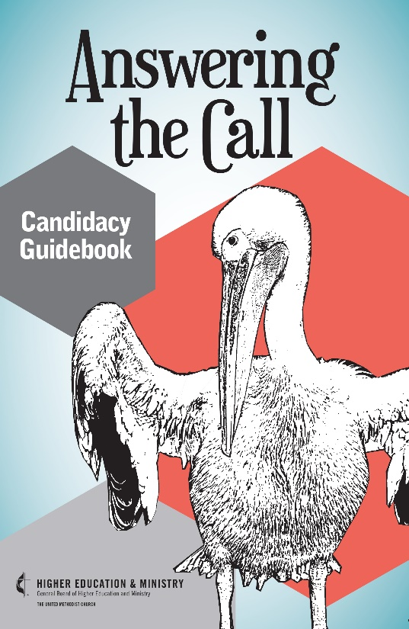
Candidacy Guidebook – Answering the Call
Designed for candidacy groups use or for one-on-one work between candidate and mentor
Reflection questions
Reorganized flow of book
Part I – Discernment, UM Beliefs, Spiritual Disciplines
Part II – Making Decisions and Process
Appendices – Mentor Meeting Guides, Steps, Candidacy Retreats
Added Chapters
Health and Wholeness
Financial Literacy

Slide 9
Other Resources
BOM Library – www.bomlibrary.org
BOM Handbook – Chapters 1 – 9
Candidacy and Conference Relations Forms
Candidacy and Conference Relations Resources
The Christian as Minister
Answering the Call
Ministry of Flyers
www.umcandidacy.org

